Slide 1

The Rights to Access Project
In December 2018, Healthwatch Warwickshire launched its Rights to Access Project (RAP). This document summarises the work we undertook in Warwick District.
The project was created as a result of the engagement work carried out across the County - talking to homeless support agencies, homeless individuals, and from reports about homelessness within Warwickshire. Our research found that people have found it difficult to access support because they lacked a permanent address, phone number or identification.
The main objective of the project is to ensure that the rights of homeless people to access healthcare treatment are promoted and protected.
12 workshops delivered: 101 attendees
We created a range of literature with information on the rights of those who are homeless to access healthcare. These resources included distributable cards for those who are homeless and the agencies who support them, and information booklets on the project for GPs and agencies.
We also offered awareness training workshops for several voluntary organisations and community groups.
19 'mystery shop' phone calls were made to GP Surgeries to find out how easy it would be for someone without an address to access care at their practice. 16 of them confirmed that they could be seen by a doctor the same day, 2 were unsure and 1 said they would redirect the patient to hospital. 9 of the practices would register the person as a temporary patient.
Warwick (Kenilworth, Leamington & Warwick)
More than 200 booklets given out
738 cards distributed
19 GP practices called

Slide 2
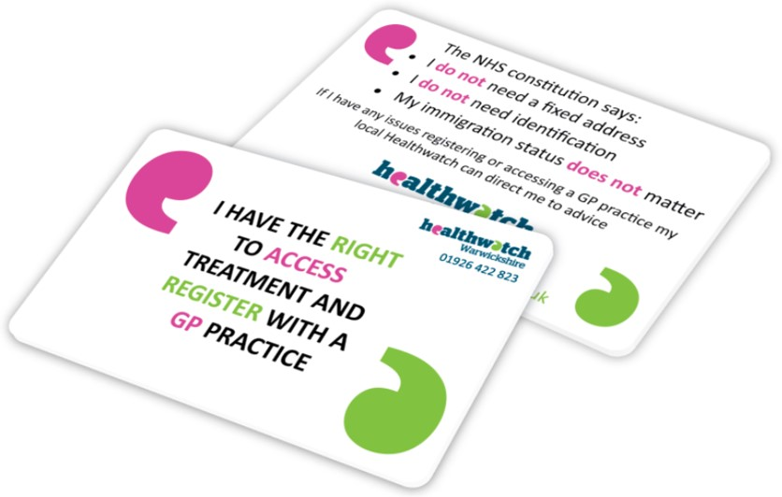
CASE STUDY: Helping a homeless man exercise his right to register with a local GP
The first phase of the project, covering Leamington, Kenilworth and Warwick, is now complete - with the next wave taking place in Stratford-Upon-Avon between May and July 2019, followed by Rugby between Aug 2019 and Oct 2019.
We will continue the project in Nuneaton and Bedworth concluding in North Warwickshire. All five phases of RAP will include a letter to all GP surgeries working closely with partner agencies and the Clinical Commission Group for each area.
A Healthwatch volunteer attended one of the RAP workshops, taking some cards and booklets away with her. She then took these to her local Church, where she discussed the project.
One of the attendees of the discussion later met a homeless person, John*, who was struggling to walk, and she told him about the project.
Subsequently John went to the Church to learn more and receive one of our cards. He then went to his GP and was able to access an appointment the same day.
The GP referred him to Warwick hospital for x-rays and physiotherapy. John was supported by the Church to attend these appointments and was given crutches by a member of the congregation.
He said that having our card had given him the confidence to go and see the GP. With help from the Church, he applied for a NHS number and a HC1, and was able to open a bank account, obtain a birth certificate and was found some temporary accommodation.
However, during the course of his treatment John was diagnosed with cancer, which was too advanced for treatment. He passed away in hospital, under the care of a dedicated ICU team who treated him with dignity and respect, and in the company of his new friends from the Church. It is a tragic end to the story but it highlights the importance of the project.
(*Not his real name.)
For more information about the project or if you would like us to host a workshop for your organisation please call: 01926 422823 or email: info@healthwatchwarwickshire.co.uk

